Slide 1
Rialto Unified School District
PRINCIPLES FOR PRINCIPALS
Student Search and Seizure
Law Enforcement Interviews on Campus
Christopher Keeler
November 12 & 14, 2024

Slide 2

Fourth Amendment
“The right of the people to be secure in their persons, houses, papers and effect, against unreasonable searches and seizures shall not be violated.”
      U.S. Constitution, Fourth Amendment

Slide 3
What is a search?
An intrusion or invasion of a person’s justifiable or reasonable expectation of privacy constitutes a search
What is NOT a search?
  “Plain View” Doctrine
  Consent
Notes:
Plain View Doctrine - If an item is left where it might be openly observed (in plain view), and the observer legitimately occupies a point where the item can be observed, there is no reasonable expectation of privacy with respect to the item and the item may be seized without a search.

Slide 4
Searches by School Personnel
Part I: Searches Based on Reasonable Suspicion

Slide 5
Student Searches
Public school officials have the right to initiate a search based on reasonable suspicion

Slide 6
What is Reasonable Suspicion?
New Jersey v. T.L.O.
In 1980, a teacher found two high school girls smoking in the restroom. Smoking was against school rules
The girls were sent to the Principal’s office
The Assistant Principal questioned the girls.
One girl admitted smoking. T.L.O. did not.

Slide 7
New Jersey v. T.L.O.
The AP took T.L.O. into his office and told her to hand over her purse, opened purse and found
  pack of cigarettes and rolling paper
  small amount of marijuana
  pipe
  empty plastic bags
  significant amount of money in dollar bills
  list of students owing T.L.O. money
  letters implicating T.L.O. as a drug dealer

Slide 8
New Jersey v. T.L.O.
The AP called T.L.O.’s mother and the police
The AP turned the purse over to the police
T.L.O. tried to have the evidence from her purse suppressed because it was obtained in violation of the 4th Amendment

Slide 9
New Jersey v. T.L.O.
US Supreme Court found:
  because schools have the need to maintain order, school officials do not need a warrant before searching a student
  School officials also are not held to the “probable cause” standard applied to law enforcement

Slide 10
In Sum: Reasonable Suspicion
Searches must be justified at their inception by reasonable suspicion
Reasonable grounds to support suspecting violation of law or school rule
Based on articulable facts and rational inference drawn from such facts
A lower standard than “probable cause”
New Jersey v. T.L.O. (1984) 105 S.Ct. 49

Slide 11
Reasonable Suspicion Examples:
Independent reports by more than one student;
Student demeanor and/or mental or physical condition;
Single, highly reliable student or a staff member;
Outside informant who provides a significant level of detail concerning the identity of the alleged wrongdoer and the specific nature and location of the contraband;
Presence at the time or location of the illegal conduct;
Suspicious conduct such as attempts to flee the scene or agitated mental condition.

Slide 12
Reasonable Suspicion (cont.)
Even if your information source is good:
  Consider the seriousness of the possible offense compared with the intrusiveness of the search;
  Consider the urgency requiring search;
  Consider the location of the student at the time of the incident leading to reasonable suspicion.

Slide 13
Practical Pointers
Get permission/consent – Avoid a dispute.
Do not be alone with the student during a search.

Slide 14
Reasonable Scope of Search
In addition to reasonable suspicion for a search, the search must be carried out in a reasonable manner.
Search limited to specific area which is the subject of the suspicion.

Slide 15

Scope of Search-Prohibited Searches:
No “strip searches.” Education Code section 49050 prohibits searches of sensitive body areas and any search which rearranges clothing to permit view of breasts, buttocks or genitalia.

Slide 16
Group Searches:
Reasonable suspicion does not have to be individualized to a particular student.
The search must still be reasonable based upon the facts.
Example: Smoke hovering over group of students.

Slide 17
Searches by School Personnel
Part II: Searches Without Reasonable Suspicion

Slide 18
Grounds for Search:
Some searches may not require reasonable suspicion if privacy invasion is minimal and important school interest is served.
Suspicionless searches should be based upon a clear policy.
Parents and students should be given notice of possibility of these searches.
These suspicionless searches are often the basis for reasonable suspicion and more intrusive searches.

Slide 19
Locker Searches:
Generally, need reasonable suspicion to search unless have a policy in place to put student on notice of regular administrative inspections or some other exception applies.
Practice of searching lockers should be supported by clear policy;
  - Notify students and parents.
  - Assert district ownership of lockers and student lack of expectation of privacy.

Slide 20
Metal Detectors:
Need procedures in place with written guidelines and prior notice.
Search everyone or random selection policy.
Hand-held wand detectors vs. stationary walk-through detectors.
Extracurricular activities (e.g. school dance) vs. entrance to schoolhouse. Different level of intrusiveness.

Slide 21
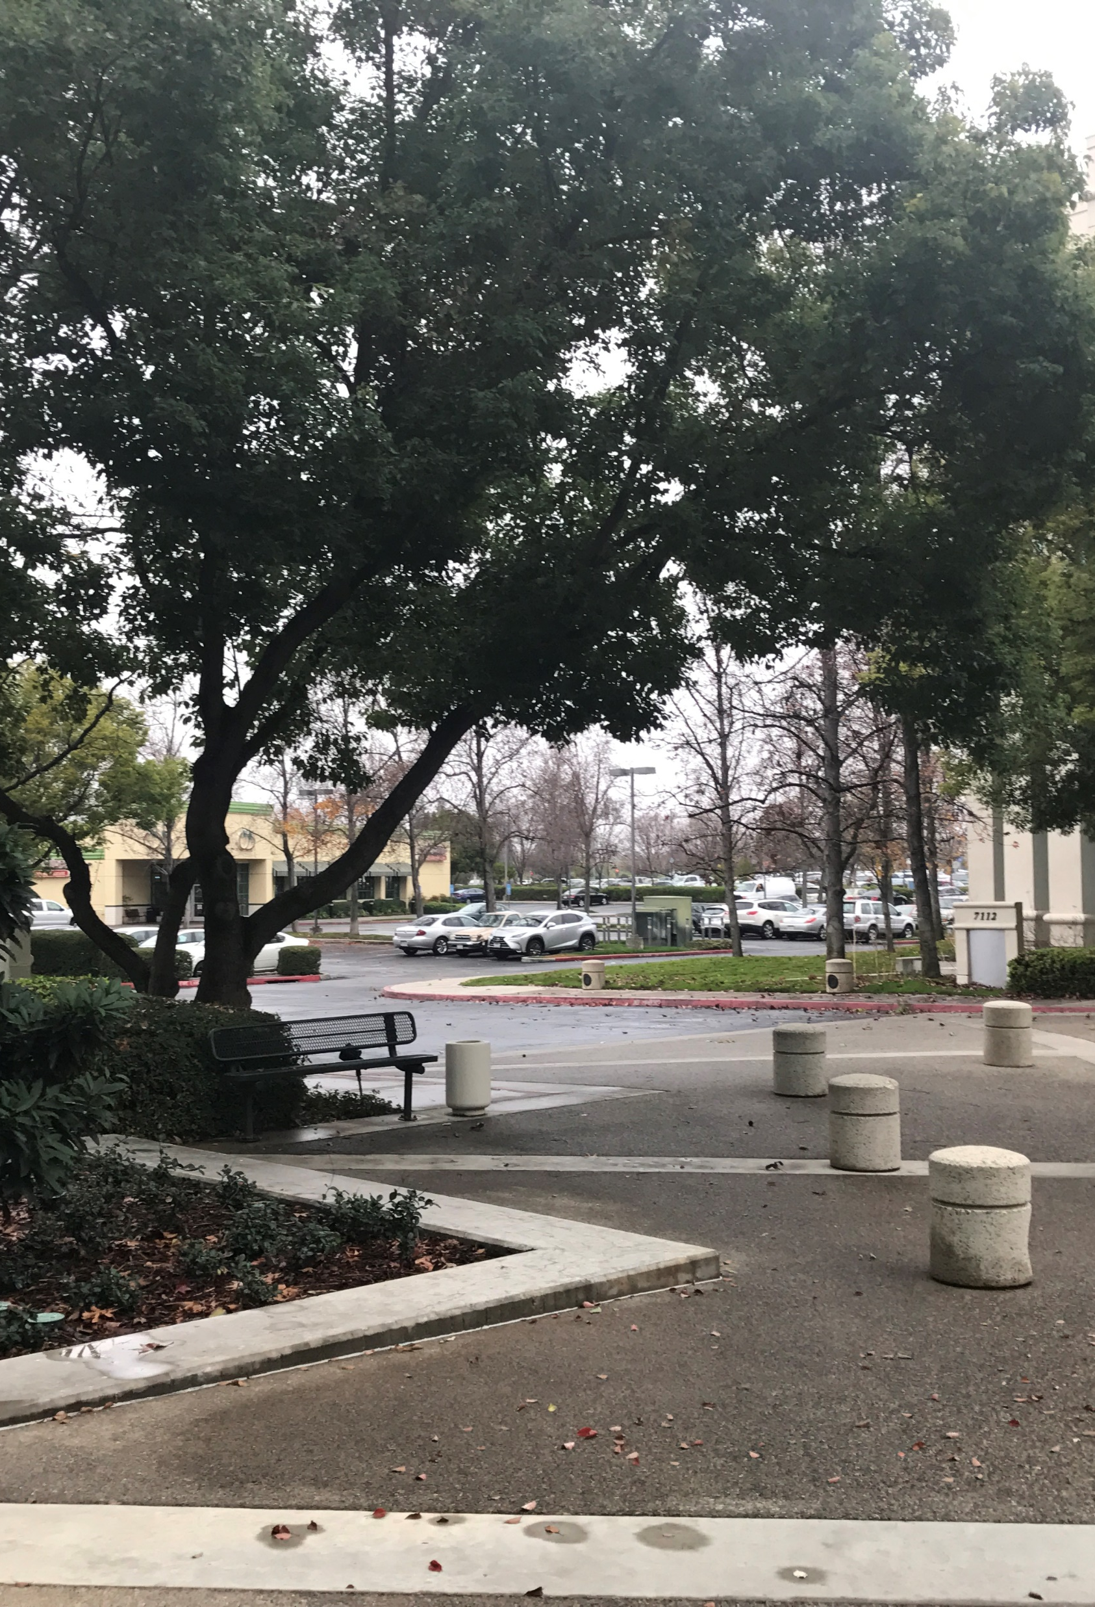
On-campus Automobiles:
Vehicles parked or driven onto school property are subject to search without suspicion pursuant to Vehicle Code section 21113;
However, notice of the search policy must be clearly posted.

Slide 22
CalECPA
California Electronic Communications Privacy Act (“CalECPA”) effective 1/1/16
Applies to “government entities” = school districts
Schools may not compel the production of, or access to, electronic device information from any person other than the device’s authorized possessor except as provided by CalECPA
Notes:
Balancing: Here, there is a balancing of
In 2014, the Supreme Court has held that law enforcement may not search digital information on a cell phone seized from an individual who has been arrested without a warrant. The Court held that there are significant privacy interests at stake given the amount of personal information that can be stored in a cell phone.
In the school context, that heightened privacy interest may be considered as well, in determining whether the scope of a search of a cell phone is reasonable.

Slide 23



CalECPA
Electronic devices include:
  Cellphones
  Laptops
  Tablets
  Any other device that stores, generates or transmits information in electronic form

Slide 24

CalECPA
Schools may access electronic device information through physical interaction or electronic communications with the device:
  With the consent of the authorized possessor of the device
  Pursuant to a search warrant

Slide 25
CalECPA
Schools may access electronic device information through physical interaction or electronic communications with the device:
  If the school believes, in good faith, that the device is lost, stolen or abandoned, as long as the school accesses information only to attempt to identify the owner
  If the school believes, in good faith, that an emergency involving danger of death or serious bodily injury requires access
  CalECPA does not prohibit schools from accessing information on a “school-issued electronic device” – usually covered through acceptable use agreement

Slide 26
Law Enforcement Searches

Slide 27

Overview: Greene v. Camreta
Issue Reviewed by the Court:
Was an in-school interview of a suspected child sexual abuse victim, absent a warrant or its equivalent, constitutional?
Ruling:
The Court of Appeals held that “the
decision to seize and interrogate S.G. in the
absence of a warrant, a court order,
exigent circumstances, or parental consent
was unconstitutional.”

Slide 28
Facts: Greene v. Camreta
Nimrod Greene was arrested for suspected sexual abuse of a 7-year-old boy. Subsequent allegations arose of sexual abuse of his daughters S.G. and K.G.
Bob Camreta, a DHS worker (CPS equivalent) learned that Nimrod was having unsupervised visits with his daughters upon his release.
Three days after receipt of the initial report of sexual abuse, Camreta, accompanied by James Alford, a uniformed deputy sheriff, went to the nine-year-old daughter’s school to interview her.
Camreta requested a private office to conduct the interview.
The interview lasted 1-2 hours and was not recorded.
Camreta concluded that Greene sexually abused his daughter.
(cont.)

Slide 29
Facts: Greene v. Camreta
Greene was indicted on six counts of felony sexual abuse.
Camreta filed a petition to have the girls removed from the home and placed in protective custody.
A physical exam was ordered and was performed absent the presence of the Sarah Greene, the girl’s mother.
The findings of the exam were inconclusive.
Sarah Greene sued DHS and the law enforcement agency alleging, in addition to other claims, an unlawful seizure of her daughter without a warrant, probable cause or parental consent – in violation of the 4th amendment right to be free from “unreasonable searches and seizures”.

Slide 30
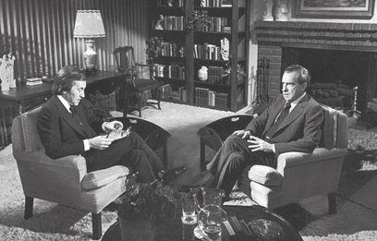
Q: What is considered to be a “search and seizure” under the 4th Amendment?
A: Whether an interview is a seizure depends on the totality of the circumstances of the interview.
One test for determining whether a person has been seized is whether a reasonable
person would have felt
free to leave or otherwise
decline the officer’s
request and terminate
the interview.

Slide 31
Factors to consider when determining if an interview is a seizure:
The length of the interview
The location of the interview
Who initiated the interview (did the victim contact the police v. the police contacting the victim)
The number of participants
The attire of the investigators (was a firearm visible)
The language and tone of the investigator
How aggressive was the questioning
Was there physical contact between the investigator and the person being interviewed

Slide 32

Q: What were the problems with the interview in Greene
A: Length of time of the interview (1-2 hours)
Presence of an armed police officer
No parental consent or warrant

Slide 33

Q: How does the 4th Amendment Apply in this Case?
A: The court relied on a 1999 decision that held that a warrantless, non-emergency search and seizure of an alleged victim of sexual abuse at her home was unconstitutional. [Calabretta v. Floyd, 189 F.3d 808 (9th Cir, 1999)]

Slide 34
“Special Need” in School Setting
The court distinguished searches and seizures by school officials from situations where a police officer or social worker, not connected with the school, conducts the interview
The court cited to the case of New Jeresy v. T.L.O., where the U.S. Supreme Court recognized a “special need” in school search cases because teachers and administrators need to be able to maintain discipline in the classroom and on school grounds.

Slide 35

“Special Need” in School Setting
The “special need” was absent in Greene because S.G. was not suspected of violating school rules and there was no need for an immediate seizure to maintain order.

Slide 36
“Reasonableness Standard”
In T.L.O., the court applied a “reasonableness” standard that is lower than what is typically required when considering 4th Amendment search and seizure violations.
In Greene, Camreta and the law enforcement officer argued that the lower standard of “reasonableness” should apply. But the Court found that the lower standard applied only to school officials, and did not apply to the caseworker.
The caseworker was serving a law enforcement purpose and was accompanied by a law enforcement officer. Thus, they were required to have a warrant/court order, parent permission, or exigent circumstances to “seize” the student and conduct the interview.

Slide 37

Q: What happened to the school district named in the lawsuit?
A: The claims against the school district were dismissed and not appealed to the Ninth Circuit so there is no discussion as to whether the school district could face liability for allowing a search by a caseworker or law enforcement absent a warrant, court order or showing of exigent circumstances.

Slide 38
Q: Does Penal Code section 11174.3 override the holding in Greene?
A: No. Penal Code section 11174.3, which specifically allows social services to come onto a school campus during school hours to interview a student suspected of being a victim of child abuse or neglect, does not trump the protections of the Fourth Amendment of the United States Constitution against unreasonable search and seizure. The Court in Greene found that the on-campus interview of the student violated the Fourth Amendment—notwithstanding Oregon state law largely identical to California Penal Code section 11174.3. Because of the similarity between California’s statutory scheme and Oregon’s, the Court’s conclusion would likely have been the same had California law been at issue.

Slide 39
Q: Does Greene still apply if the social worker acts without a law enforcement officer?
A: The Court gave no clear indication that the absence of the police officer would have changed the outcome of the case. The court focused on the interviewers serving a “law enforcement purpose.” Child Protective Services often collaborates with law enforcement and often there are no clear distinctions between civil and criminal consequences that could arise from a CPS investigation. For that reason, we advise applying the same procedures to law enforcement and CPS investigators.

Slide 40

Q: Does Greene prohibit district staff from speaking with a student about possible abuse?
A: No. Pursuant to Penal Code section 11166, district staff are mandatory reporters of child abuse and must report known or reasonably suspected instances of child abuse or neglect.
As the Court specifically noted, nothing in Greene
alters this obligation or prohibits staff from asking a student about possible abuse.

Slide 41
Q: What is the status of qualified immunity under Greene?
A: Qualified immunity shields district staff from liability when their conduct does not violate a clearly established right of which a reasonable person would have known.
The Court noted emphatically that government officials will not be insulated from liability if they adopt a blanket position that child abuse investigation interviews can be conducted outside the warrant requirement of the Fourth Amendment. Thus, in order to preserve their claim to qualified immunity, school officials should ensure that an interview does not take place without a warrant, court order, parental consent, or exigent circumstances.

Slide 42
Q: Can a school district rely on the representation of law enforcement or a CPS investigator that exigent circumstances exist to permit the interview?
A: Yes. Exigent circumstances exist if the social worker or law enforcement officer has “reasonable cause to believe that the child is likely to experience serious bodily harm in the time that would be required to obtain a warrant.” There is no authority placing the onus on district officials to confirm the existence of exigent circumstances. That duty belongs to the government employees seeking to interview the student.

Slide 43
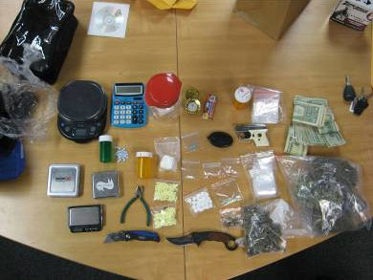
Q: Does Greene prohibit searches/seizures related to drugs, weapons, or other suspected disciplinary issues?
A: No.
Greene does not alter the District's ability to interview and/or search students suspected of having drugs or weapons
You should conduct such searches/seizures and notify law enforcement in the same manner you would have prior to Greene

Slide 44
Q: When does an interview become a seizure?
A: It Depends!
School staff/safety officers are obligated to maintain school safety
Stops or detentions for these purposes will general not violate a student's rights so long as they are not arbitrary or capricious
Stopping a student to ask a question is not a seizure
Detaining a student for three hours following multiple reports of possession of drugs likely is not an unreasonable seizure
Taping a student's head to a tree for five minutes = unreasonable seizure!
Detaining a student for five hours after questionable report of drugs likely is an unreasonable seizure

Slide 45
Christopher Keeler
Notes:
Redesign or set master image

